Slide 1
Simple diode model
Sonya Stuhec-Leonard

Slide 2
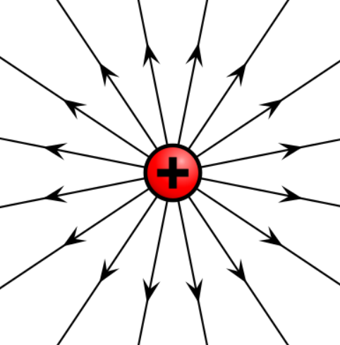

Review of Electrodynamics
Electric charges have electric fields
Coulomb's Law
$$F=\frac{kq_{1}q_{2}}{r^{2}}$$
https://en.wikipedia.org/wiki/Electric_charge

Slide 3
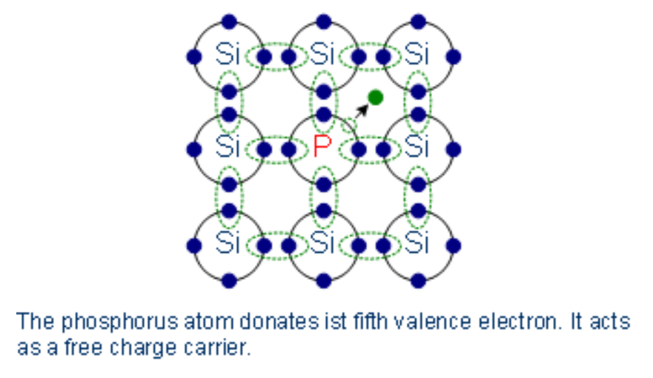
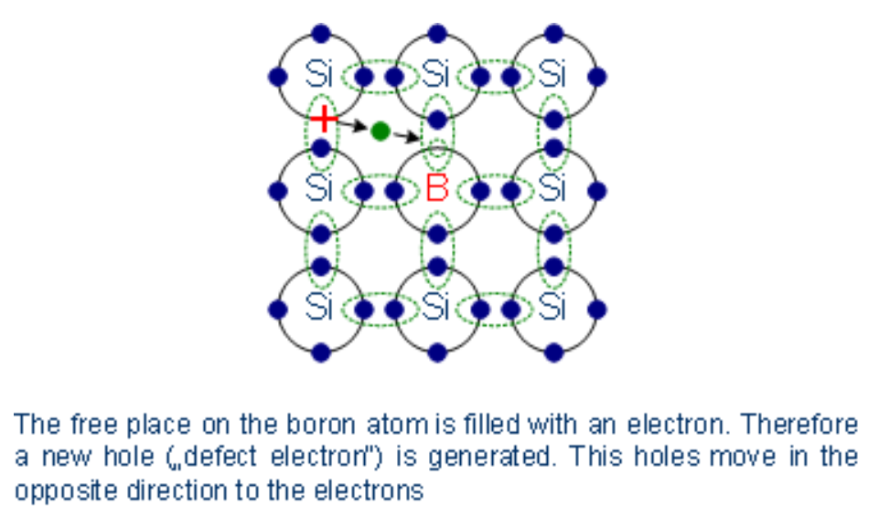
How does a diode work?
Doping (acceptors and donors)
For n-type doping type V elements (one free electron in lattice)
For p-type doping type III elements (one free hole in lattice)
https://www.halbleiter.org/en/fundamentals/doping/

Slide 4
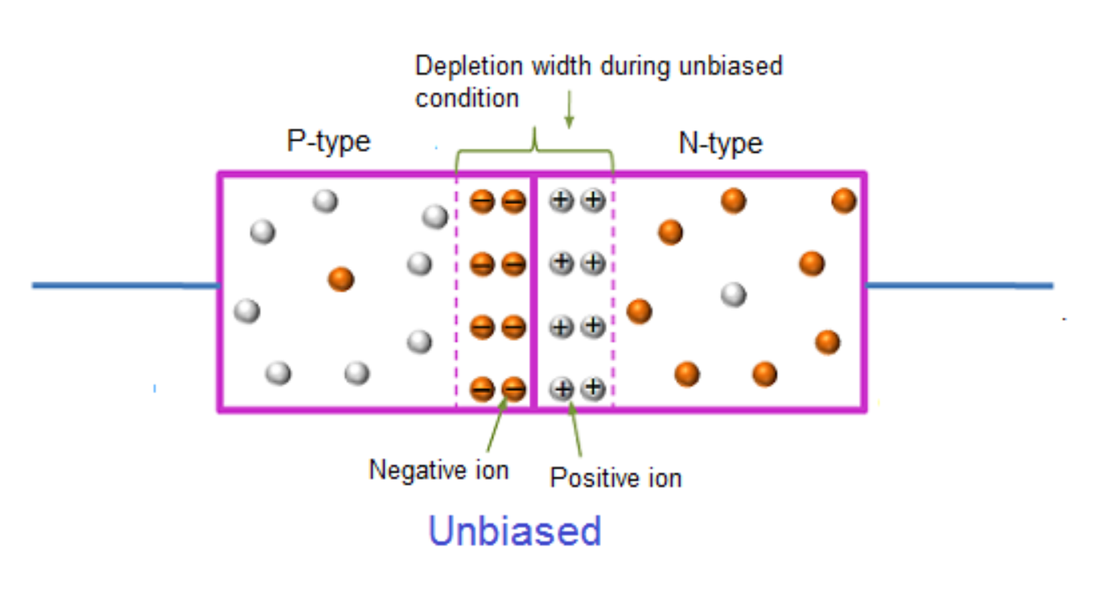
PN junction
Without an applied voltage the depletion region will form as some of the acceptors and donors combine to crease a neutral region.
The n and p regions remain uncharged, with particles not having the potential energy required to penetrate the formed depletion region.
http://www.physics-and-radio-electronics.com/electronic-devices-and-circuits/semiconductor-diodes/forwardbiasedpnjunctionsemiconductordiode.html

Slide 5

Conductivity
Conductivity is the measure of ease of flow
$$σ=\frac{e^{2}nτ}{m_{e}} (1)$$

Slide 6
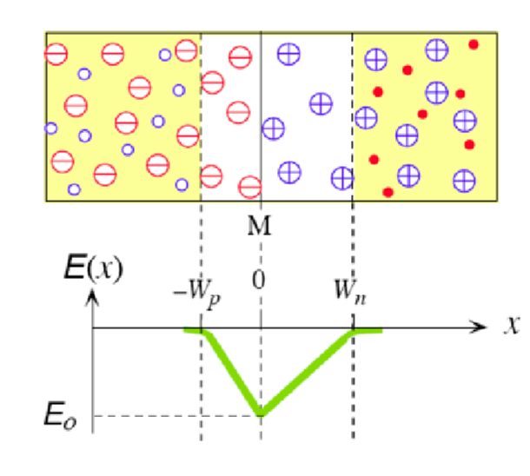

Electric field
Electric field is produced by the difference in change across the device
$$E\left(x\right)=\frac{1}{ε}\int_{−W_{p}}^{x}{\frac{1}{σ_{net}(x)}} dx (2)$$

Slide 7
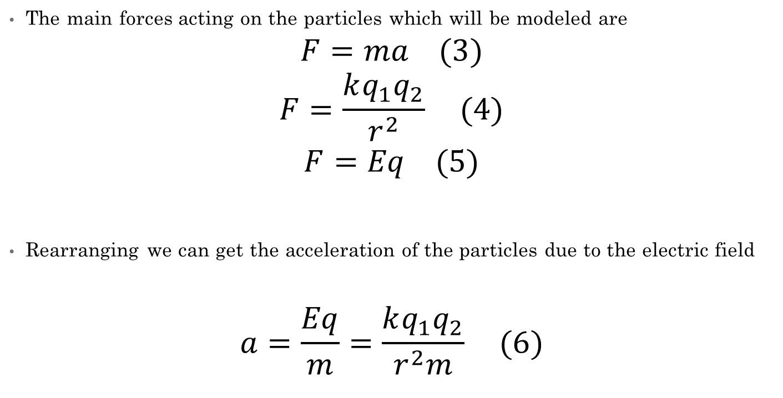
Forces on particles
The main forces acting on the particles which will be modeled are
$$F=ma (3)$$
$$F=\frac{kq_{1}q_{2}}{r^{2}} (4)$$
$$F=Eq (5)$$
Rearranging we can get the acceleration of the particles due to the electric field
$$a=\frac{Eq}{m}=\frac{kq_{1}q_{2}}{r^{2}m} (6)$$

Slide 8
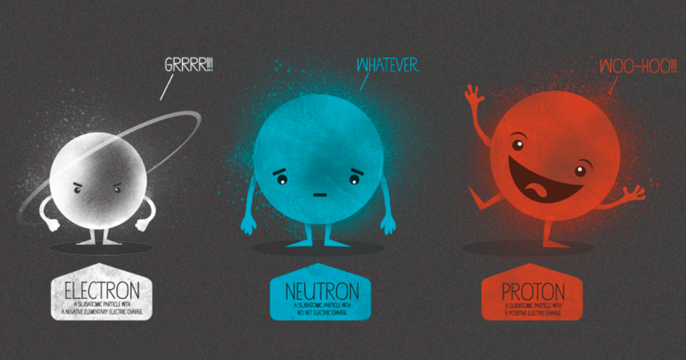

Model
Define particle parameters
Charge
Mass
Mean scattering time ($τ_{MN}$)

Slide 9
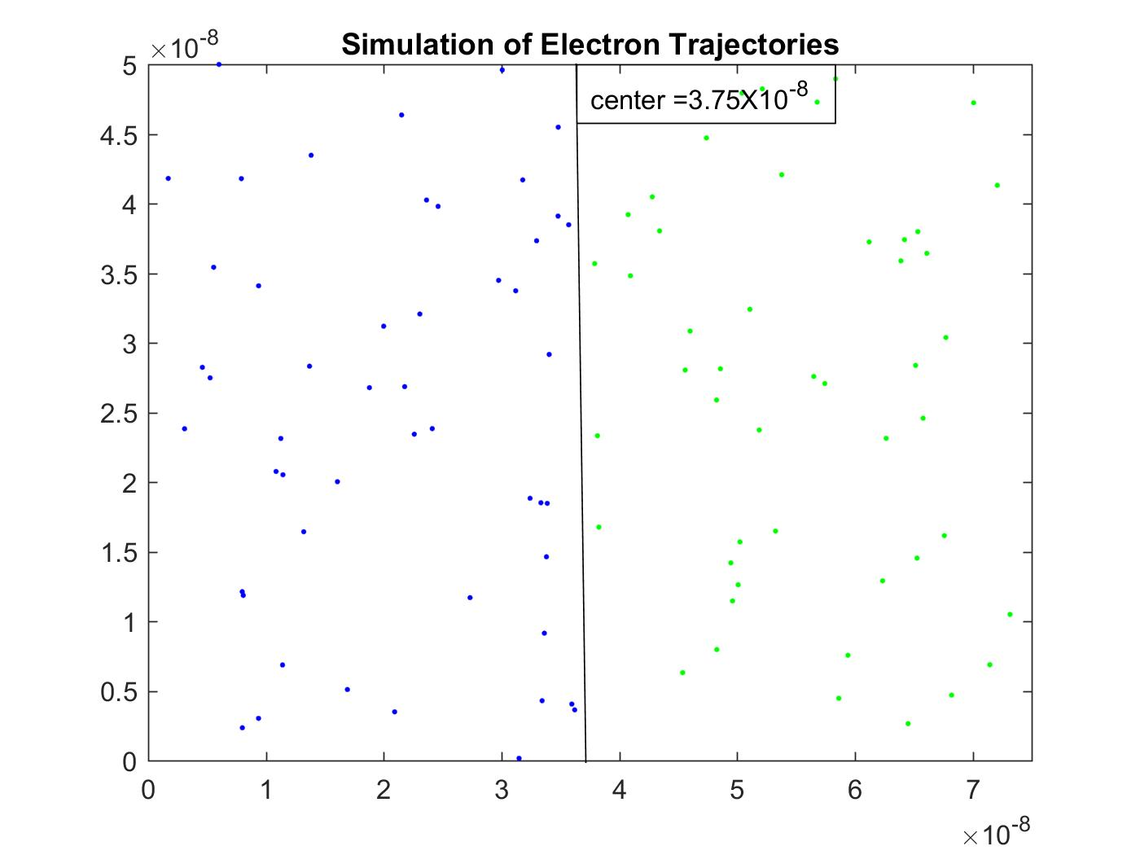
Initialization
Monte Carlo initialization
Normally distributed velocities and positions within defined regions

Slide 10
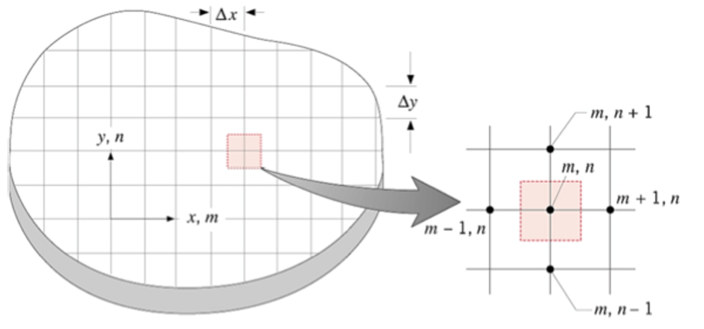
Methods
Choose method
Use FD to solve providing E-field of depletion region
Create conductivity map using equation (1)
Simplified to three regions, n, p, dep
Use physical properties to model behavior

Slide 11

Simplifications to the model
Doping concentration for n and p types unknown
Would like to have calculation to determine from the doping used (material, concentration)
Used fixed concentrations for given number of system particles
$$Electrons=Holes=N$$

Slide 12
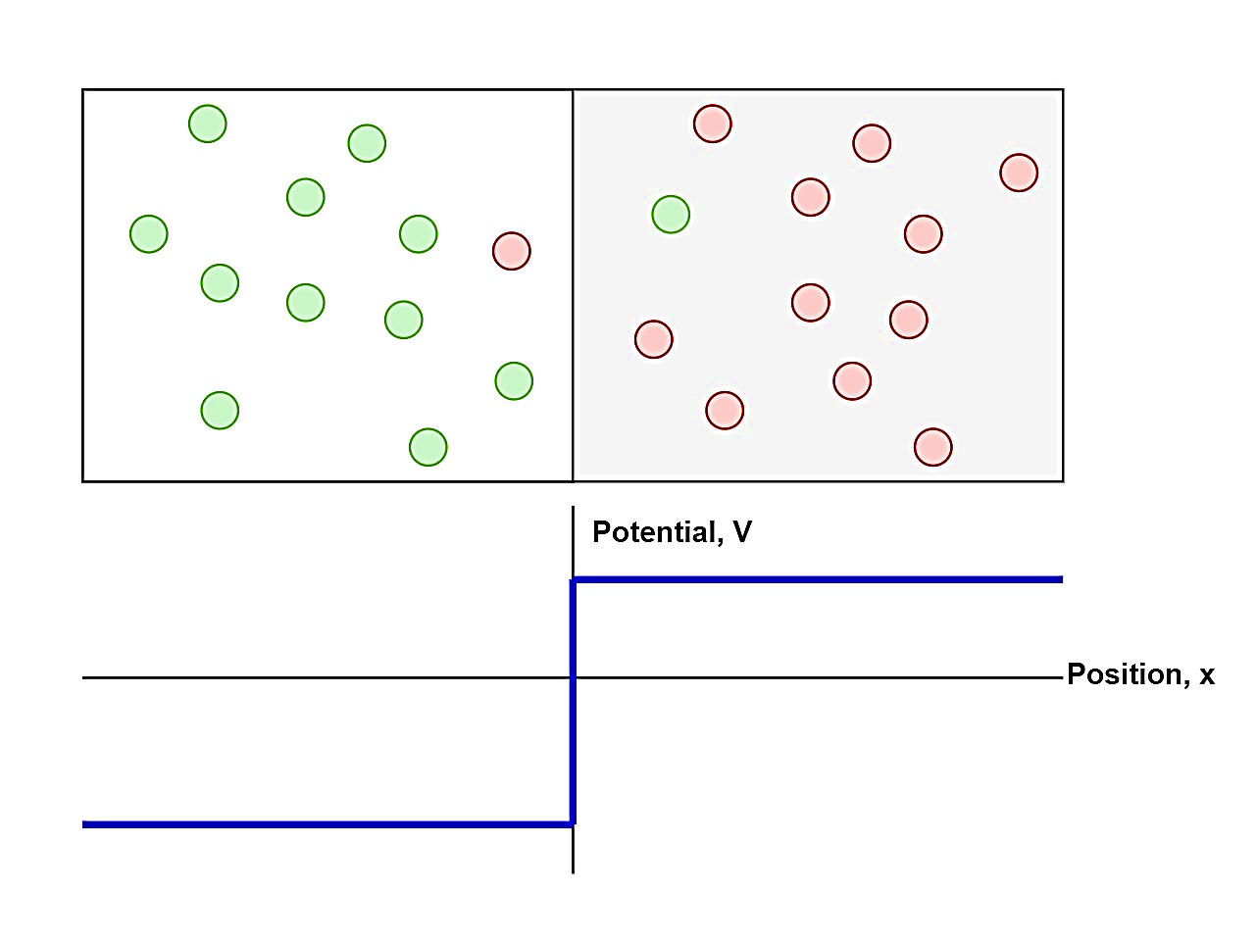
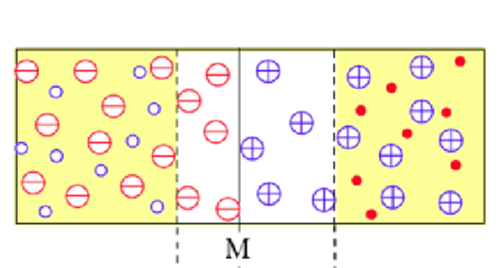
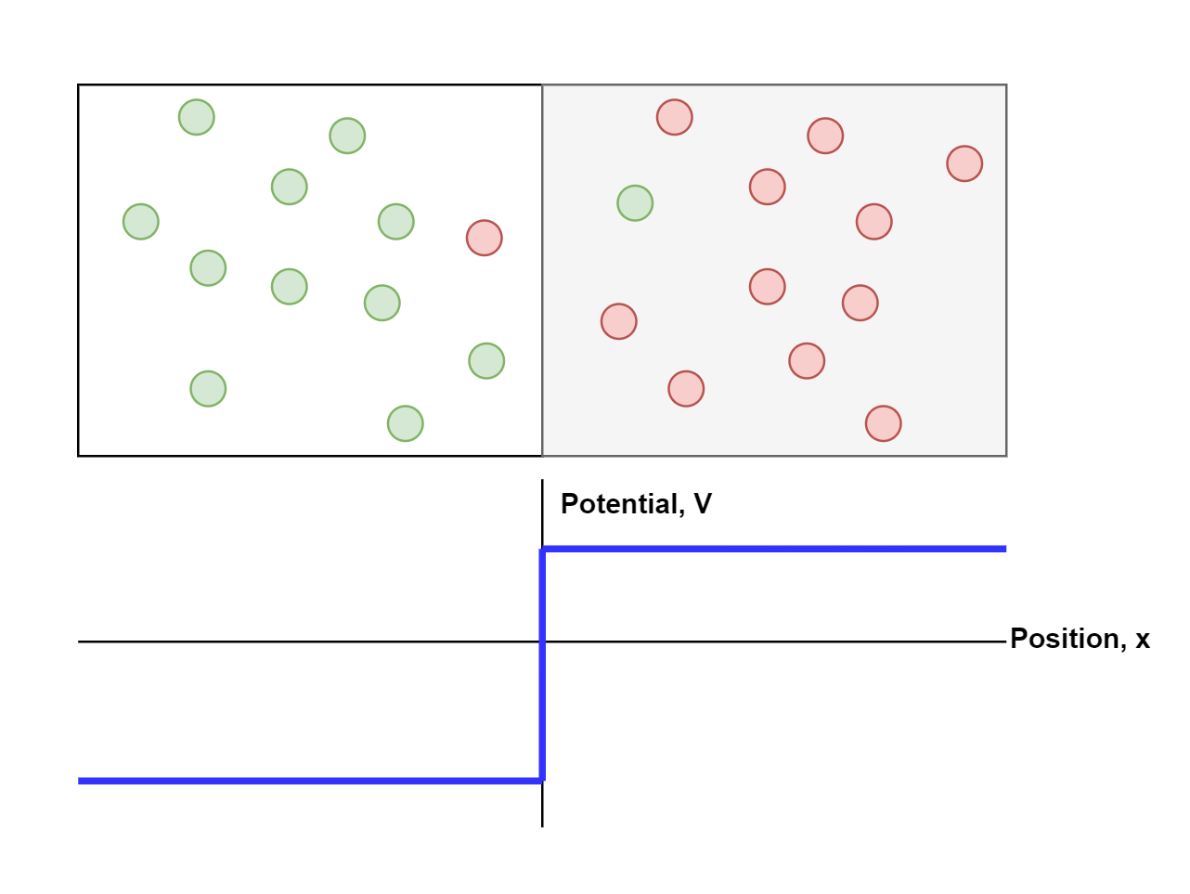
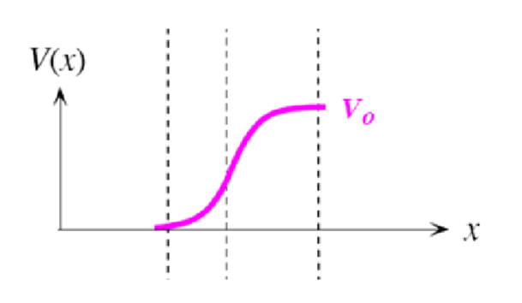
Barrier vs Depletion Region
Depletion region initially easier to enter, harder to leave
Reduce probability of leaving and ensure that if particle will leave it requires Energy sufficed to enter the outside doped region
Simulated electric barrier
Diode depletion region

Slide 13
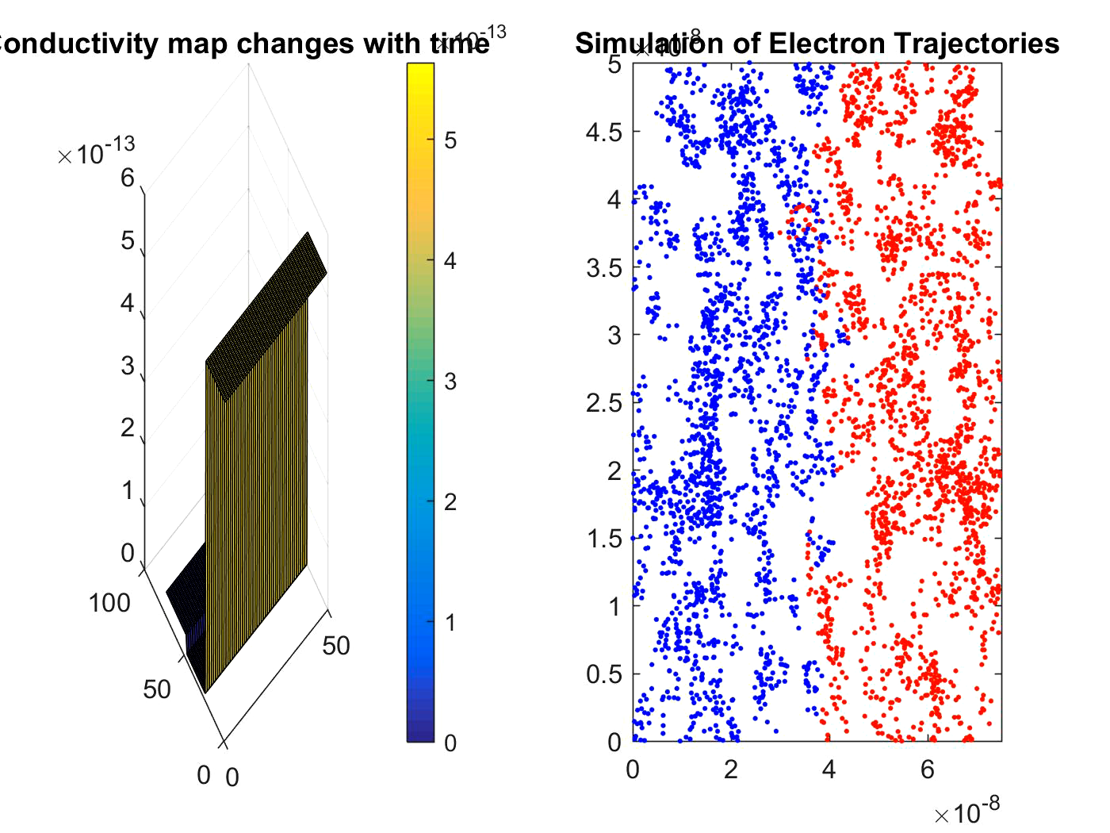
Simulation

Slide 14
Future work
Determine energy of the depletion region
Currently using temporary value only good for testing code
Working on incorporating forces between particles (Coulomb's law)
Expected to increase probability of scattering
Apply voltage
Effects of forward and reverse bias
Breakdown region would require supporting code
Insert hot electrons and determine the effects
Also requires supporting code to deal with different temperatures

